Slide 1

Machine Learning for Credit Card Fraud Detection Project
Team Members
Alja Chinnu Thomas
Ann Mary Jose

Slide 2

Abstract
Objective: Develop a machine-learning model to detect credit card fraud
Challenges: Handling imbalanced dataset and minority class identification
Methodology: Data analysis, preprocessing, Random Forest and XGBoost classifiers, hyperparameter tuning
Findings: High accuracy but challenges with detecting minority class (fraudulent transactions)
Conclusion: Need for specialized techniques and continued research

Slide 3

Introduction
Context: Rise of credit card fraud in the digital banking era
Problem: Inadequacy of traditional, rule-based fraud detection systems
Project Objective: Utilize machine learning algorithms to detect fraud in real-time
Goal: Develop a model that accurately distinguishes between legitimate and fraudulent transactions

Slide 4

The Challenge of Credit Card Fraud
Complexity: Difficulty in identifying unauthorized card use amidst legitimate transactions
Impact: Financial loss, consumer trust, and privacy concerns

Slide 5

Problem Statement
Transaction Patterns: Variability in legitimate transactions influenced by various factors
Imbalanced Data: Less than 1% of transactions are fraudulent
Model Bias: Tendency to overlook the minority class (fraudulent transactions)
Necessity for Advanced Methods: Beyond standard accuracy metrics, need for specialized techniques

Slide 6

Tackling Class Imbalance
Strategies: Resampling, specialized cost functions, anomaly detection
Challenges: Balancing detection accuracy and computational complexity

Slide 7

Market Analysis for Fraud Detection
Market Growth: From USD 19.5 billion (2018) to USD 63.5 billion (2023)
CAGR: 26.60%, driven by digital finance and rising cybercrime
Trends: Shift from traditional rule-based systems to AI and machine learning

Slide 8

Need for Advanced Fraud Detection
Evolving Threats: Continuous evolution of fraudster techniques
Dynamic Solutions: Machine learning's adaptability in detecting complex patterns
Importance: Essential for financial institutions' competitive edge and customer trust

Slide 9

New Market Opportunities
Emerging Players: Fintech startups, cybersecurity firms, software providers
Innovation: Development of more effective, cost-efficient fraud detection solutions
Accessibility: Lowering barriers for smaller institutions to adopt advanced fraud prevention

Slide 10
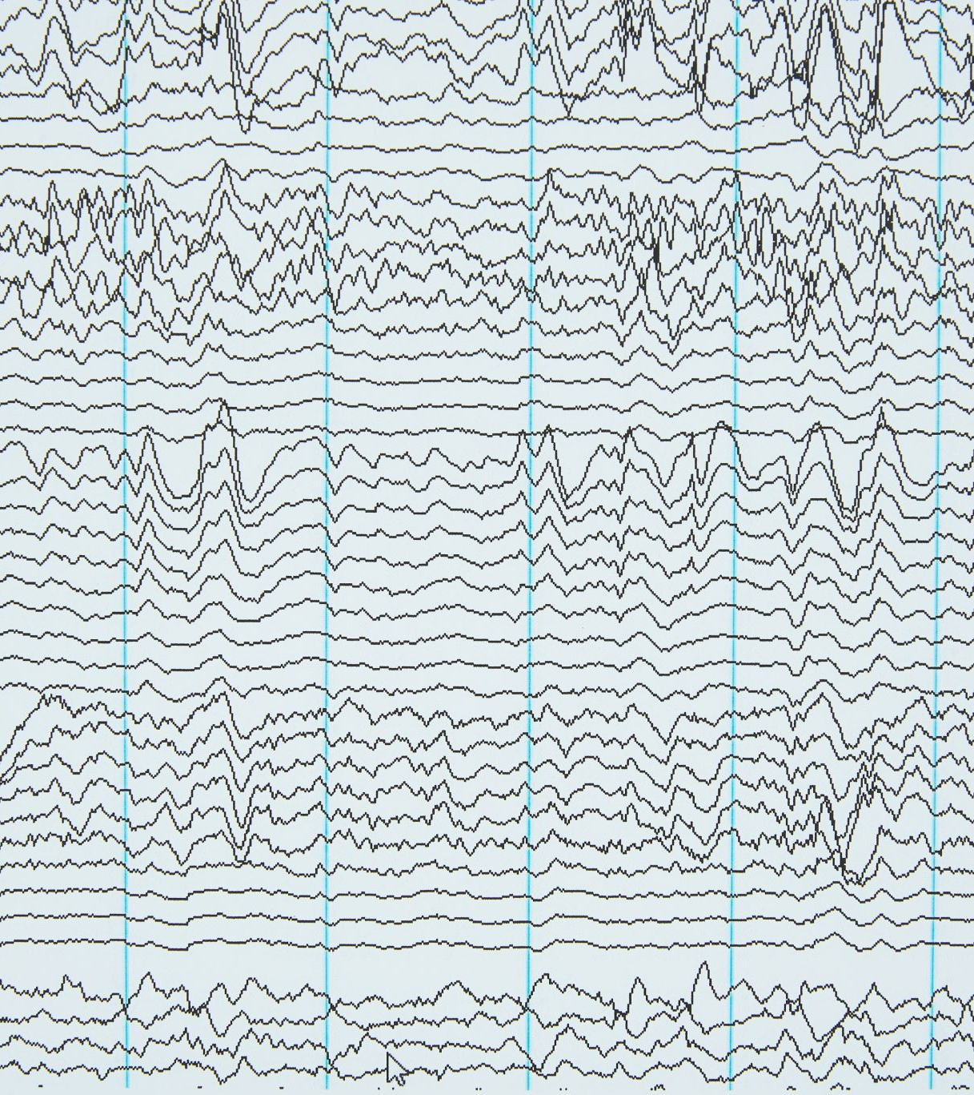
Data Analysis Techniques
Dataset Overview: 284,807 transactions, 0.172% fraudulent
Features: PCA-transformed variables (V1-V28), 'Time', and 'Amount'
Analysis Approach: Histograms, box plots, correlation matrices to identify fraud indicators
Feature Engineering and Preprocessing
Feature Engineering: Limited due to PCA, potential exploration of 'Time' derived features
Scaling: Standardization of 'Amount' for consistent model input
Class Imbalance: Use of SMOTE for balancing the dataset

Slide 11

Model Implementation with Random Forest
Algorithm Choice: Random Forest for its handling of complex, high-dimensional data
Strengths: Effective in diverse feature environments, robust against overfitting
Hyperparameter Tuning and Model Selection
Tuning Process: Utilizing GridSearchCV for optimal parameter selection
Key Hyperparameters: n_estimators, max_depth, min_samples_split
Performance Metrics: Emphasis on precision, recall, F1-score, and ROC-AUC

Slide 12
Results and Discussion - Overview
High accuracy of the model: Approximately 99.96%
Importance of scrutinizing model performance due to data imbalance
Confusion Matrix Insights
Correctly identified 15,397 legitimate and 22 fraudulent transactions
Incorrectly flagged 1 legitimate transaction; missed 6 fraudulent transactions
Precision and Recall
Recall for fraudulent transactions: 78.57%
Precision for fraudulent class: 95.65%
F1-Score and ROC-AUC Score
F1-Score as a balanced metric for precision and recall
Strong ROC-AUC score, indicating excellent model performance

Slide 13
Strengths and Weaknesses of the Model
Strengths: Robust against overfitting, suitable for unbalanced datasets
Weaknesses: Computationally intensive, 'black box' nature hinders interpretability

Slide 14
Financial Impact and Risk Analysis
Potential savings: €38,492 from effective fraud detection
Importance of balancing false positives and negatives
Reduction in manual reviews, lowering labor costs
Risks: Overfitting and maintenance costs

Slide 15
Conclusion
Effectiveness of the Random Forest classifier in fraud detection
Importance of considering metrics beyond accuracy
Highlighting the potential of machine learning in enhancing financial security

Slide 16
Future Work and Directions
Experimenting with additional feature engineering
Regular model updates with new data
Exploring deep learning techniques
Developing methods for model explainability

Slide 17
References
ReportBuyer. (2018, December 5). The global fraud detection and prevention (FDP) market size is expected to grow from USD 19.5 billion in 2018 to USD 63.5 billion by 2023, at a Compound Annual Growth Rate (CAGR) of 26.6%. PR Newswire. https://www.prnewswire.com/news-releases/the-global-fraud-detection-and-prevention-fdp-market-size-is-expected-to-grow-from-usd-19-5-billion-in-2018-to-usd-63-5-billion-by-2023--at-a-compound-annual-growth-rate-cagr-of-26-6-300760746.html
Credit card fraud Detection. (2018, March 23). Kaggle. https://www.kaggle.com/datasets/mlg-ulb/creditcardfraud/data

Slide 18

Thank You

